Slide 1

DEEP LEARNING INTRODUCTION

Slide 2
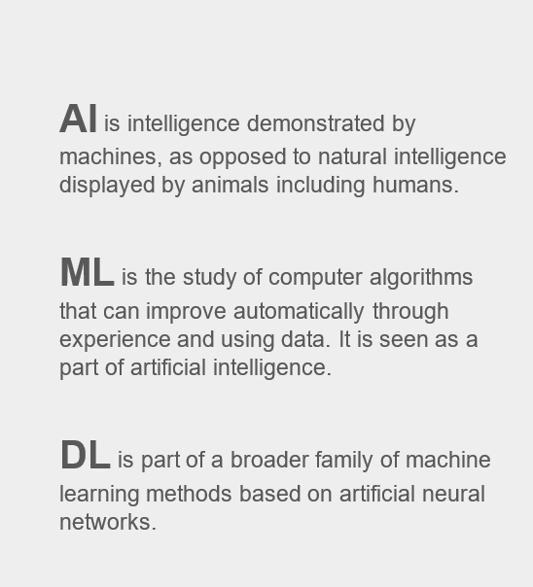
Artificial Intelligence (AI), Machine Learning (ML), and Deep Learning (DL)

Slide 3
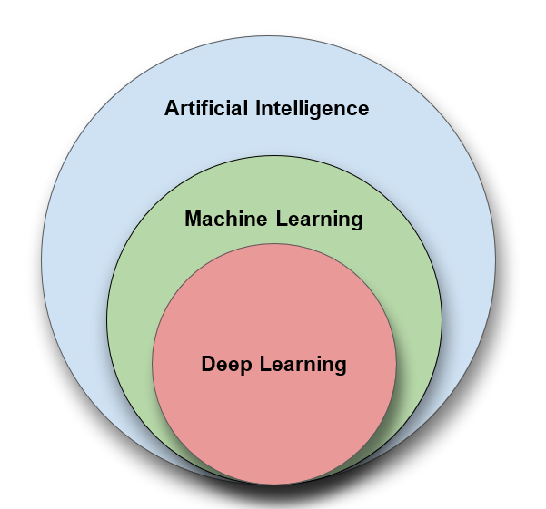
Relationship of AI, ML and DL

Slide 4
Artificial Intelligence (AI) is anything about man-made intelligence exhibited by machines.
Machine Learning (ML) is an approach to achieve AI.
Deep Learning (DL) is one technique to implement ML.

Slide 5
What is Deep Learning?
Deep learning is a class of machine learning algorithms that:
use a cascade of multiple layers of nonlinear processing units for feature extraction and transformation. Each successive layer uses the output from the previous layer as input.
learn in supervised (e.g., classification) and/or unsupervised (e.g., pattern analysis) manners.
learn multiple levels of representations that correspond to different levels of abstraction; the levels form a hierarchy of concepts.

Slide 6
Why Deep Learning?
Limitations of traditional machine learning algorithms
not good at handling high dimensional data.
difficult to do feature extraction and object recognition.
Advantages of deep learning
DL is computationally expensive, but it is capable of handling high dimensional data.
feature extraction is done automatically.

Slide 7
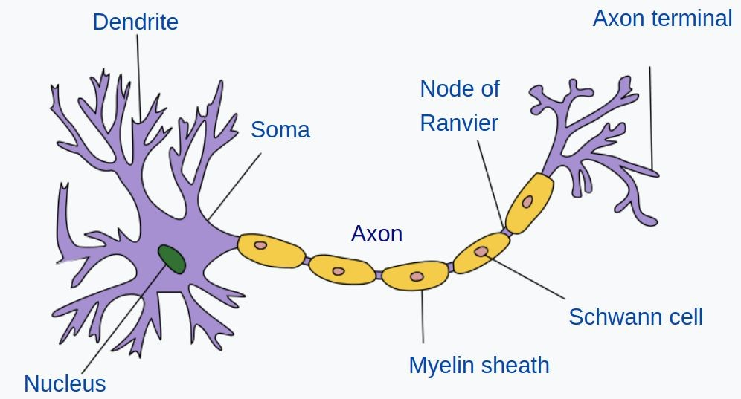


Artificial Neural Network
Input
Hidden Layers
Output

Slide 8
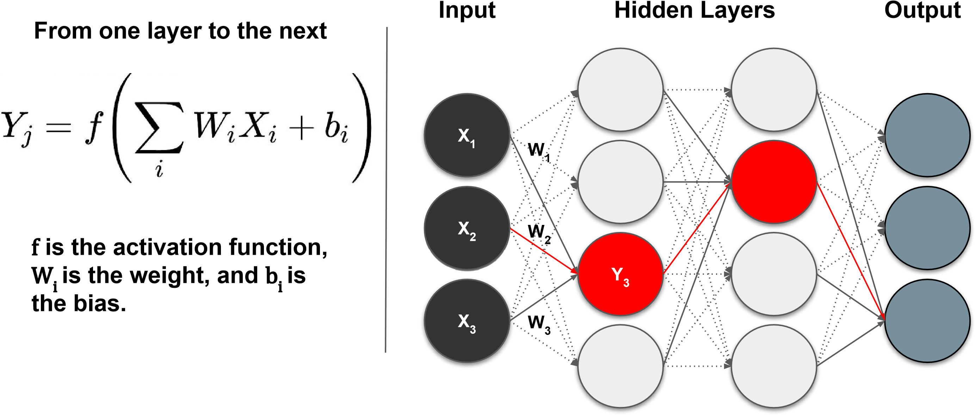
Supervised Deep Learning with Neural Networks

Slide 9
Activation function, Bias.
Definition:
Activation functions introduce non-linearity into the neural network, enabling it to learn complex patterns.
Purpose:
Transform the weighted sum of inputs into an output.
Decide whether a neuron should be activated or not.
Enable the network to solve non-linear problems.
Key Idea:
Without activation functions, a neural network would behave like a linear regression model.

Slide 10
Linear Activation Function: Output = Weighted Input (used rarely).
Non-linear Activation Functions:
Sigmoid: Compresses output between 0 and 1.
Tanh: Compresses output between -1 and 1.
ReLU (Rectified Linear Unit): Output = max(0, input), helps with sparse activation.
Leaky ReLU: Allows small gradient for negative inputs.
Softmax: Used for multi-class classification problems.
Bias:
Definition: Bias is an additional parameter added to the weighted sum of inputs to
shift the activation function.
Purpose:Allows the model to better fit the data.
Enables the network to learn patterns that do not pass through the origin.
Helps avoid symmetry issues in neurons.
Mathematically: Z=W⋅X+BZ where: W: Weights , X: Input , B: Bias

Slide 11
Problem.

